Slide 1



We Believe In the Power of Work
Notes:
<Lauren>

Slide 2



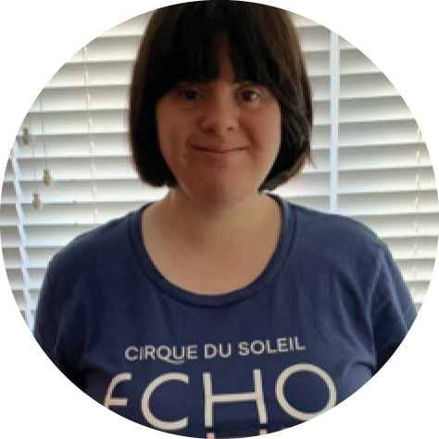


Accommodation Does Not Equal Hardship
CASE STUDY
Engage
Our client, Cirque du Soleil, opened the big top to collaborate with us and our partner, the Canadian Down Syndrome Society’s (CDSS) Inployable program.
Collectively, we worked to ‘think differently’ by providing training and coaching to attract, onboard, and employ this workforce.
Employ and Empower
We had 3 associates with Down syndrome attend the orientation for the Toronto show. They joined the team as ushers / ticket scanners.
This incredible group scanned tickets, welcomed guests, and moved through the job duties assigned with the support of job coaches . All completed their assignments successfully, gaining valuable skills in the process.
Thank you for taking a chance on having Amanda work at Cirque this summer. It means so much to Amanda to be working there and she tells everybody about it.
Gayle Carter
Amanda’s Mom
Provided meaningful employment to Canadians from an underrepresented population
From a professional perspective, this partnership shows us that there are many individuals outside our traditional candidate market who are ready and able to work. From a personal perspective, this was one of the most rewarding experiences in my career.
I saw Amanda greeting guests and directing them to the correct doors verbally and motioning with her hands! This is an incredible and huge step for Amanda. I am over the moon proud of her and my assisting team for their efforts.

Slide 3
Onboarding
REMEMBER OUR OWL SYSTEM
EXPLAIN
SHOW
DO
REPEAT
Explain the task, do the task, have the employee do the task, and have the employee repeat the task
If possible, start with shorter shifts and build up to longer shifts.
Give information in shorter phrases and provide training visuals.
Remember that every individual is different and will have unique needs.

